Slide 1
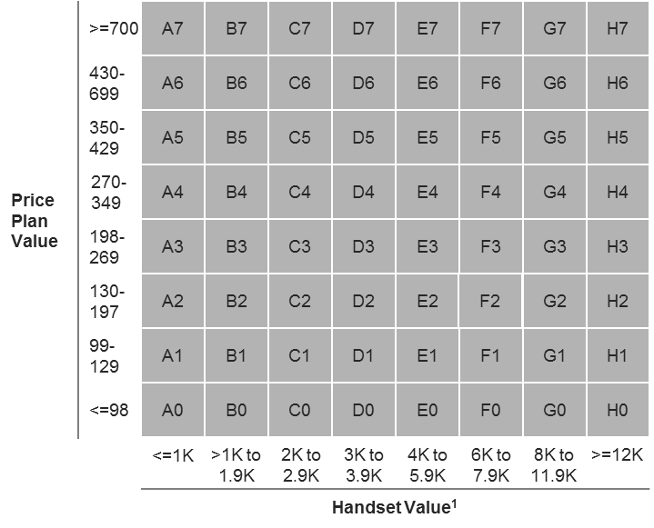
Telco in EEMA – We developed a framework to allocate optimal funding to postpaid deals taking into consideration gross margin, target base migration and competitor pricing
Telecommunications (TMT) | EEMA
TEL012
Situation
What we did
Impact
Large telco in EEMA with 4.5bn (local currency) revenue in consumer postpaid segment
Postpaid revenue shrinking along with high subscription churn necessitated a refresh in their postpaid product portfolio
Recognized the need to make the new postpaid packages competitive by creating attractive handset deals
Developed a deals framework that will cluster all the deals into a 8x8 matrix – created based on categorizing price plan value and handsets into 8 groups
Currently the telco follows a static process to fund all price plans irrespective of the handset or deal the plan is part of which is margin dilutive,
Hence the framework and the process of funding will enable the following –
Identify only a handful of deals that would need funding and the channels on which they are pushed
The weight of funding on those deals will be determined in line with competition’s funding
The weight of funding will vary across deals to enable upsell during contract renewal and to increase gross connections/footfall to stores
Synthesized the competitor deals in to the above matrix to identify the key areas where they fund and also to identify the weight of funding across different deal clusters
Optimized the telco’s funding budget combining the insights from above two steps and set up a process that would systematically allow the telco to create deals with appropriate and competitive funding every month on the right marketing channels

